Slide 1
ME759 High Performance Computing for Applications in Engineering [Spring 2020]
Lecture 20
03/09/2020
Dan Negrut, 2020 ME759 UW-Madison

Slide 2
Quote of the day [on the day when the stock market dropped 1884 points on opening and triggered a trading halt]
“I lost our life savings in the stock market. Now let's move on to the real issue: Lisa's hogging of the maple syrup.”
-- Homer Simpson, Safety Inspector[1989 -].

Slide 3
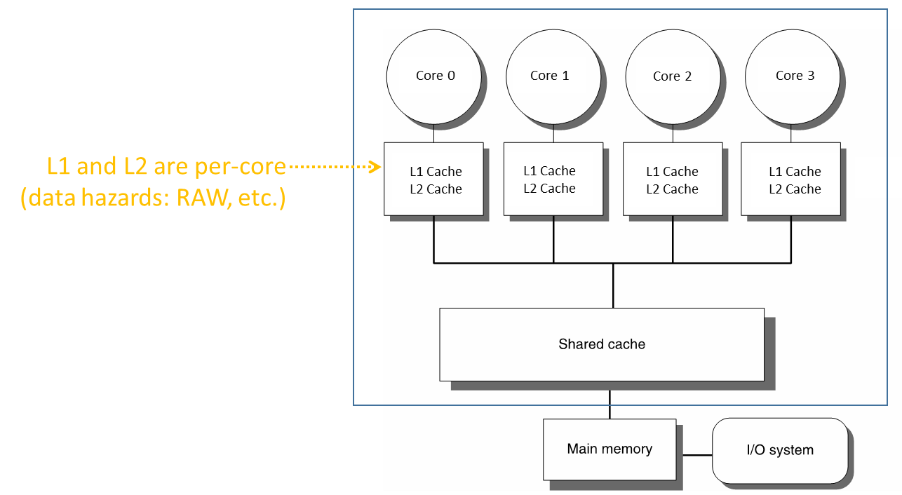
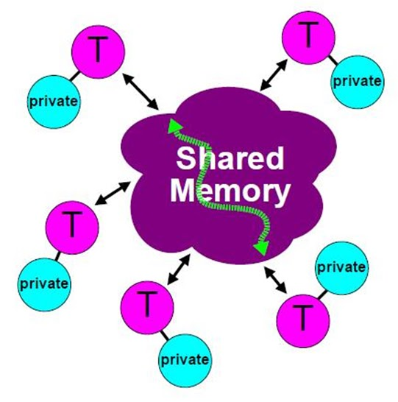
Before we get going…
Last time:
CUB
Multi-core parallel computing
Hardware consideration
Getting started with OpenMP
Today:
OpenMP generalities
Work-sharing constructs in OpenMP
Other tidbits:
ME759 Exam: April 15, at 7:15 PM, in 1106ME
Review: Tu, April 14, at 7:00 PM, in Canvas
Next time: further disucssion of default projects

Slide 4
Compiler Directives, Examples
Directive | Description
atomic | Specifies that a memory location will be updated atomically
barrier | Synchronizes all threads in a team; all threads pause at the barrier, until all threads execute the barrier
critical | Specifies that code is only executed on one thread at a time
flush | Specifies that all threads have the same view of memory for all shared objects
for | Causes the work done in a for loop inside a parallel region to be divided among threads
master | Specifies that only the master thread should execute a section of the program
ordered | Specifies that code under a parallelized for loop should be executed like a sequential loop
parallel | Defines a parallel region, which is code that will be executed by multiple threads in parallel
sections | Identifies code sections to be divided among all threads
single | Indicates that a section of code should be executed on a single thread, not necessarily the master thread
threadprivate | Specifies that a variable is private to a thread
[MSDN]→
Notes:
Some are more important than others…

Slide 5
OpenMP Beyond Directives: User-Level Runtime Routines
Examples of function calls supported by OpenMP API:
Modify/check the number of threads
omp_[set|get]_num_threads()
omp_get_thread_num()
omp_get_max_threads()
Are we in a parallel region?
omp_in_parallel()
How many processors in the system?
omp_get_num_procs()
Explicit locks
omp_[set|unset]_lock()
Many more...
[IOMPP]→
Notes:
Script:
More detail on the API info
Next foil
Background

Slide 6
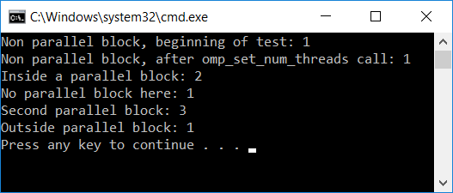
Example: Set/Get Number of Threads
// omp_get_num_threads.c
// compile with: /openmp
#include <stdio.h>
#include <omp.h>
int main() {
printf_s("Non parallel block, beginning of test: %d\n", omp_get_num_threads());
omp_set_num_threads(2); // NB: run-time action, sets OpenMP behavior
printf_s("Non parallel block, after omp_set_num_threads call: %d\n", omp_get_num_threads());
#pragma omp parallel
#pragma omp master
{
printf_s("Inside a parallel block: %d\n", omp_get_num_threads());
}
printf_s("No parallel block here: %d\n", omp_get_num_threads());
// changed the number of threads to be used inside parallel block;
// to that end, use a compiler directive...
#pragma omp parallel num_threads(3) // NB: compile-time clause
#pragma omp master
{
printf_s("Second parallel block: %d\n", omp_get_num_threads());
}
printf_s("Outside parallel block: %d\n", omp_get_num_threads());
}

Slide 7
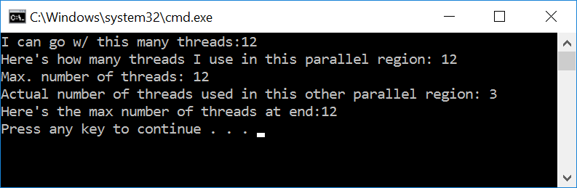
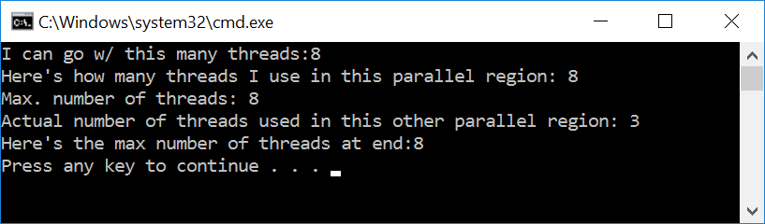
Example: Get Max Number of Threads
#include <stdio.h>
#include <omp.h>
int main() {
//omp_set_num_threads(8);
printf_s("I can go w/ this many threads:%d\n", omp_get_max_threads());
#pragma omp parallel
#pragma omp master
{
printf_s("Here's how many threads I use in this parallel region: %d\n", omp_get_num_threads());
}
#pragma omp parallel num_threads(3)
#pragma omp master
{
printf_s("Max. number of threads: %d\n", omp_get_max_threads());
printf_s("Actual number of threads used in this other parallel region: %d\n", omp_get_num_threads());
}
printf_s("Here's the max number of threads at end:%d\n", omp_get_max_threads());
return 0;
}
the maximum number of threads that can be used to form a new team if a parallel region without a num_threads clause is encountered
Got this after uncommenting the first line in main() function

Slide 8
OpenMP: Anchored by Three Pillars
Pillar 1: Compiler directives [introduced already]
Allows for incremental parallelization of the code
A compiler that doesn’t speak OpenMP simply ignores pragmas
Code runs just like before; i.e., sequentially
Directives have clauses, to further qualify a directive’s behavior
Pillar 2: User-level runtime function calls [introduced already]
Your compiler needs to link against the OpenMP library
You really need access to OpenMP, directives won’t do
Pillar 3: Environment variables [discussed now]
Another way of controlling OpenMP behavior
Provides some of the support that the OpenMP functions provide
Addresses portability issue – helps you bypass use of run-time function calls

Slide 9
Example, two ways to accomplish the same thing
Example 1: controlling the number of threads – the following are equivalent
omp_set_num_treads(8)
For the C shell: setenv OMP_NUM_THREADS 8
For the Bash shell: export OMP_NUM_THREADS=8
For the Windows shell: set OMP_NUM_THREADS=8
Example 2: controlling nested parallelism – the following are equivalent
omp_set_nested(1);
export OMP_NESTED=1

Slide 10
OpenMP: Environment Variables, two quick remarks
Environment Variables team up with compiler directives so that you don’t need to call any OpenMP function
Then, it is truly that if you don’t have an OpenMP-aware compiler you are totally fine
The code will work sequentially, oblivious to any OpenMP directives you pepper in the code
Good to know: A function call setting trumps an Environment Variable setting

Slide 11
Function calls or Env Vars? Which one is better?
Not all function calls in OpenMP API have an Environment Variables counterpart
Therefore, you can tune better behavior at run-time via function calls
There’s a lot of function calls, not that many Environment Variables
Limitation of Env Vars: once execution started, you can’t dynamically change an Env Var setting
Can’t change env variable OMP_NUM_THREADS while code runs

Slide 12
OpenMP Env Variables, some examples…
OMP_CANCELLATION: |  | Set whether cancellation is activated
OMP_DISPLAY_ENV: |  | Show OpenMP version and environment variables
OMP_DEFAULT_DEVICE: |  | Set the device used in target regions
OMP_DYNAMIC: |  | Dynamic adjustment of threads
OMP_MAX_ACTIVE_LEVELS: |  | Set the maximum number of nested parallel regions
OMP_MAX_TASK_PRIORITY: |  | Set the maximum task priority value
OMP_NESTED: |  | Nested parallel regions
OMP_NUM_THREADS: |  | Specifies the number of threads to use
OMP_PROC_BIND: |  | Whether theads may be moved between CPUs
OMP_PLACES: |  | Specifies on which CPUs the threads should be placed
OMP_STACKSIZE: |  | Set default thread stack size
OMP_SCHEDULE: |  | How threads are scheduled
OMP_THREAD_LIMIT: |  | Set the maximum number of threads
OMP_WAIT_POLICY: |  | How waiting threads are handled

Slide 13
OpenMP: Putting Things in Perspective
OpenMP: portable and scalable model for shared memory parallel applications
No need to dive deep and work with POSIX pthreads
Code becomes portable
Under the hood
Compiler translates OpenMP functions and directives to pthread calls
Program begins with a master thread
Master thread[s] forked when hitting a parallel region

Slide 14
What’s the Scope of a Directive?
Directives: What does the OpenMP standard say?
“An OpenMP executable directive applies to the succeeding structured block or an OpenMP construct.”
structured block: talk about it next
OpenMP construct: defer discussion till “Work sharing” segment of lecture
structured block and OpenMP construct are the two sides of the “parallel region” coin

Slide 15
Structured Blocks (C/C++)
structured blocks
A block with one point of entry at the top and one point of exit at the bottom
The only “branches” allowed are exit() function calls
A structured block
Not a structured block
#pragma omp parallel
{
int id = omp_get_thread_num();
more: res[id] = do_big_job (id);
if( not_conv(res[id]) )goto more;
}
printf (“I’m outside par. region!\n");
if (go_now()) goto more;
#pragma omp parallel
{
int id = omp_get_thread_num();
more: res[id] = do_big_job(id);
if ( conv (res[id]) ) goto done;
goto more;
}
done: if (!really_done()) goto more;
IMPORTANT FACT: There is an implicit barrier at the right “}” curly brace where threads wait on each other. This is the point at which the spawned worker threads complete execution and either go to sleep or spin idle.
[IOMPP]→
Notes:
Script:
A Parallel region is created using the #pragma omp parallel construct. A master thread creates a pool of worker threads once the master thread crosses this pragma. On this foil, the creation of the parallel region is highlighted in yellow and includes the pragma and the left curly brace “{“. The parallel region extends from the left curly brace – to the highlighted yellow right curly brace “}”. There is an implicit barrier at the right curly brace and that’s the point at which the other worker threads complete execution and either go to sleep or spin or otherwise idle.
Parallel constructs form the foundation of OpenMP parallel execution. Each time an executing thread enters a parallel region, it creates a team of threads and becomes master of that team. This allows parallel execution to take place within that construct by the threads in that team. The following directives are necessary for a parallel region:
#pragma omp parallel
A parallel region consists of a structured block of code.
We see on the left a good example of a structured block of code where there is a single point of entry into the block at the top of the block, and one exit to the block at the bottom – AND no braches out of the block.
Question to class – can someone spot some reasons why this block is unstructured?
Here are a couple of reasons that that block is unstructured – multiple entrances and multiple exits to the block.
We see on the right a bad example - or an unstructured block of code.
Here we have two entries in the block – one from the top of the block and one from the goto more statement which jumps into the block at the label “more:”
Additionally, the bad example has multiple exits from the block:
1) From the bottom of the block and one from the goto done statement

Slide 16
Example, Parallel Regions
You ask the runtime to set up four threads
Each of the four threads executes in parallel the code in between the curly brackets
The threads wait for each other right before the cout statement, at which point all threads except master are folded back into pool
The right curly bracket “}”; i.e., end of parallel region, acts as a barrier
printf statement only executed by master
Important: each thread has own “threadID”-type variable
Like threadIdx.x in CUDA – allows to identify what work you do
//perhaps more code here (defining foo, etc.)
double myData[1000];
omp_set_num_threads(4);
#pragma omp parallel
{
int threadID = omp_get_thread_num();
foo(threadID, myData);
}
printf("all done\n");
//perhaps more code here

Slide 17
Another Way to Look at It
// perhaps more code here (defining foo, etc.)
double myData[1000];
omp_set_num_threads(4);
#pragma omp parallel
{
int threadID = omp_get_thread_num();
foo(threadID, myData);
}
printf("all done\n");
//perhaps more code here
myData[1000];
omp_set_num_threads(4);
Each thread executes the same code, arguments slightly different because of threadID
foo(0,myData)
foo(1,myData)
foo(2,myData)
foo(3,myData)
All four foo function calls executed with the same myData; each of the four calls does what it finds suitable based on the value of threadID
printf("all done\n");
Barrier; three of the threads are folded, after which master thread moves on

Slide 18
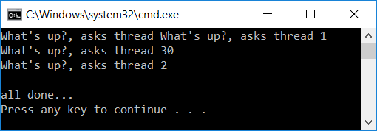
Parallel Regions, Another Example
#include "omp.h"
#include <iostream>
void whatsUpQuestionMark()
{
int myThreadID = omp_get_thread_num();
std::cout << "What's up?, asks thread " << myThreadID << std::endl;
}
int main()
{
#pragma omp parallel num_threads(4)
{
whatsUpQuestionMark();
}
std::cout<< "all done...\n";
return 0;
}
What do you get when you execute this code?
The code in the parallel region is like a GPU kernel (a “structured block”), which gets called by the number of parallel threads you work with

Slide 19
whatsUpQuestionmark Example: What Happens Under the Hood
#pragma omp parallel num_threads(4)
{
whatsUpQuestionMark();
}
void thunk() // wrapper, useful when having a function w/ arguments
{
whatsUpQuestionMark();
}
pthread_t tid[4];
for (int i = 1; i < 4; ++i) //note that i starts at 1
pthread_create(&tid[i], 0, thunk, 0); //create 3 threads
thunk(); // this is the call done by master thread
for (int i = 1; i < 4; ++i) //three threads folded; see Remarks below
pthread_join(tid[i]);
The OMP compiler generates code logically (qualitatively) analogous to that on the right of this slide, given an OMP pragma such as the one above
The OMP runtime uses a thread pool so full cost of thread creation and retiring is not incurred with each parallel region
Only three threads are created because one parallel-section invocation associated with master thread
Remarks
Thread creation happens perhaps before, don’t need to create threads over and over again
The threads might not be joined, they’re folded back into a pool to avoid overhead when used in the next parallel region
[ Mattson, Breshears, Koniges, Kemp ]→

Slide 20
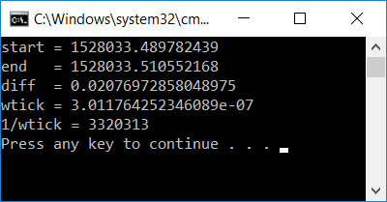
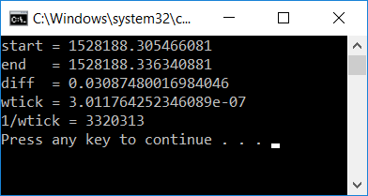
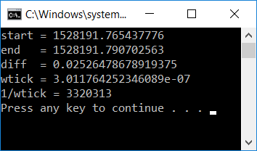
Timing an OpenMP Application
What to pay attention to in example below:
double omp_get_wtime() – returns a value in seconds of the time elapsed from some arbitrary, but consistent point in the past guaranteed not to change during execution of program
double omp_get_wtick() – returns the number of seconds between clock ticks
Dictates the resolution that you can be expecting out of a timing call
#include "omp.h"
#include <stdlib.h>
#include <stdio.h>
#include <math.h>
int main() {
int const N = 100000;
double dummy[N];
double start = omp_get_wtime();
for (int i = 0; i < N; i++) {
int temp = rand();
dummy[i] = 2.*temp / (pow(temp*temp, 1.5) + 0.2);
}
double end = omp_get_wtime();
printf_s("start = %.16g\n", start);
printf_s("end = %.16g\n", end);
printf_s("diff = %.16g\n", end - start);
double wtick = omp_get_wtick();
printf_s("wtick = %.16g\n", wtick);
printf_s("1/wtick = %.16g\n", 1.0 / wtick);
}

Slide 21
[new topic] Nested Parallelism in OpenMP
Backdrop:
You have a block of code that is executed in parallel
Inside that block, there is a “for” loop that is executed in parallel
Questions:
What happens in this case?
How can you control what happens?
Is what happens desirable or undesirable?

Slide 22
Nested Parallelism: A closer look
A small window into the execution flow of an OpenMP program
Sequential execution regions
F o r k
Join
F o r k
J o i n
F o r k
J o i n
Fork
Join
Another parallel region
A parallel region
Interested in what happens here…
Master thread
Slave thread

Slide 23
Nested Parallelism: What Happens & How to Control
When a thread, call it Joe, on a team of threads hits a parallel region, it spawns a collection of threads of which Joe is the master
Is it always like this?
No, you can actually control behavior
If you prohibit the existence of nested parallel regions in your code, a parallel thread encountering a new parallel region will not be able to spawn new parallel threads
That embedded parallel region newly encountered will be executed by thread “Joe” only

Slide 24
Nested Parallelism: What Happens & How to Control
API to control nested parallelism behavior
Invoke library routine omp_set_nested()
OMP_NESTED environment variable
Function call provides fine level of control
In some parts of the code nested parallelism is ok
Some other parts are better off without nested parallelism

Slide 25
Relevant Actors, Nested Parallelism
Relevant API elements
omp_set_dynamic(…)
omp_get_dynamic(…)
omp_set_nested(…)
omp_get_nested(…)
Note: There are equivalent clauses and/or environment variables that accomplish the same thing
Provides mechanism to control whether the number of threads available in subsequent parallel region can be adjusted by the runtime library. If argument is nonzero, the runtime library can adjust the number of threads. If argument is zero, the runtime library cannot dynamically adjust the number of threads.

Slide 26
The OMP single directive
single directive identifies a section of code that must be run by a single thread
Example: see next slide,
Example highlights several features
single directive
omp_set_dynamics (…)
omp_set_nested(…)

Slide 27
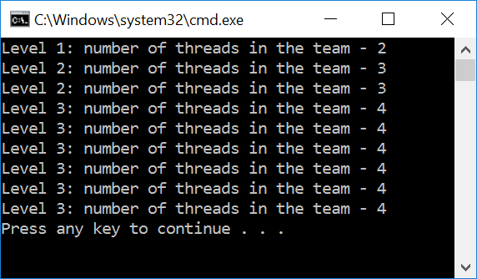
Example [wicked, think about what happens in the code below]
#include <omp.h>
#include <stdio.h>
void report_num_threads(int whichLevel)
{
#pragma omp single
{
printf("Level %d: number of threads in the team - %d\n", whichLevel, omp_get_num_threads());
}
}
int main() {
omp_set_dynamic(1);
omp_set_nested(1);
#pragma omp parallel num_threads(2)
{
report_num_threads(1);
#pragma omp parallel num_threads(3)
{
report_num_threads(2);
#pragma omp parallel num_threads(4)
{
report_num_threads(3);
}
}
}
return(0);
}
Please reflect on this: thread maintains context even when alone inside of function call

Slide 28
“setting” and “getting: their scope
set methods affect only parallel regions at same or inner nesting levels encountered by the calling thread
The mechanics of it
Upon creation of a team of threads, slave threads inherit values from master thread
get methods return values associated with the calling thread

Slide 29
Departing Thoughts – 1
Nested parallel regions: an immediate way to engage more threads in a computation
Nesting parallel regions prone to create large number of threads
Number of threads created: the product of the number of threads forked at each level of nested parallelism
Example: N threads at outer level, each creating M threads at inner level – N*M threads
Looming danger: oversubscribe the system. Might slow you down…
Function calls and environment variables available to manage tightly the spawning of threads
[Argonne Natnl. Lab]→

Slide 30
Departing Thoughts – 2
Examples of good reasons to employ nested parallelism
Insufficient parallelism at outer level
Many-core processors today can handle many threads
IBM POWER9 chip: handles 96 threads
Example: have outer loop w/ 10 trips on a 64 core workstation
Load balance problems: more threads in flight can help balance the load
[Argonne Natnl. Lab]→

Slide 31
Nested Parallelism: Food for Thought
Backdrop: Creating any parallel region entails some overhead
If you want to avoid this overhead and also avoid oversubscription
Should you parallelize the inner loop?
Should you parallelize at the outer loop?

Slide 32
Work Plan, OpenMP
What is OpenMP?
Parallel regions
Work sharing
Variable Scoping Issues
Synchronization
Performance issues
Loose ends

Slide 33
Work Sharing
Work sharing: general term used in OpenMP to describe distribution of work across threads
Three primary avenues for work sharing in OpenMP:
omp for construct
omp sections construct
omp task construct
Each of them automatically divides work among threads

Slide 34
Work sharing, an alternative to GPU-style parallel computing
Recall previous discussion:
structured block: we already defined what this is
Enables GPU-style parallel computing – each thread executes the same structured block
OpenMP construct: talk about this next

Slide 35
Work Plan, OpenMP
What is OpenMP?
Parallel regions
Work sharing – Parallel for loops
Variable Scoping Issues
Synchronization
Loose ends

Slide 36
The omp for Directive
// assume N=12 <-- !!!
#pragma omp parallel
#pragma omp for
for(i = 0; i < N; i++)
c[i] = a[i] + b[i];
Threads are assigned an independent set of iterations
Threads must wait at the end of work-sharing construct
#pragma omp parallel
#pragma omp for
i = 0
i = 1
i = 2
i = 3
i = 4
i = 5
i = 6
i = 7
i = 8
i = 9
i = 10
i = 11
Implicit barrier
[pic above assumes three threads are in the thread team]
[IOMPP]→

Slide 37
Combining Constructs
These two code segments are equivalent
#pragma omp parallel
{
#pragma omp for
for ( int i=0;i< MAX; i++) { res[i] = huge();
}
}
#pragma omp parallel for
for (int i=0;i< MAX; i++) {
res[i] = huge();
}
There is an implicit barrier here.
(at the end of the parallel region, that is)
[IOMPP]→

Slide 38
Problems with default partitioning
Most OpenMP implementations use as default block partitioning
Each thread is assigned roughly n/thread_count iterations
This may lead to load imbalance when the work per iteration varies
(assume the time required by a call to f(i) is proportional to i)
sum = 0;
for(i = 0; i <= n; i++)
sum += f(i);
What would be a good partitioning of iterations over threads in this case?

Slide 39
The schedule Clause
The schedule clause affects how loop iterations are mapped onto threads
schedule(static [,chunk])
Blocks of iterations of size chunk assigned to each thread
Round robin distribution
Low overhead, may cause load imbalance
schedule(dynamic[,chunk])
Threads grab chunk iterations
When done with iterations, thread requests next set of chunk iterations
Higher threading overhead, can reduce load imbalance
schedule(guided[,chunk])
Dynamic schedule starting with large block
Size of the blocks shrinks; no smaller than chunk though
[IOMPP]→

Slide 40
schedule Clause Example
Iterations are divided into chunks of 8
If start = 3, then first chunk is
i={3,5,7,9,11,13,15,17}
#pragma omp parallel for schedule(static, 8)
for( int i = start; i <= end; i += 2 )
{
if ( TestForPrime(i) ) gPrimesFound++;
}
[IOMPP]→

Slide 41
Loop Scheduling (Assume 3 Threads)
iteration
0
1
2
3
4
5
6
T0
7
8
T1
9
T2
10
11
12
13
14
15
16
17
18
19
STATIC
STATIC, 3
DYNAMIC [,1]
DYNAMIC, 3
GUIDED [,1]

Slide 42
Choosing a Schedule
STATIC best if you know you have balanced loops – least overhead
STATIC,n good for loops with mild or smooth load imbalance
Prone to introduce “false sharing” (discussed later)
DYNAMIC useful if iterations have widely varying loads
Prone to adversely impact data locality (cache misses)
GUIDED often less expensive than DYNAMIC
Beware of loops where first iterations are the most expensive
Credit: Alan Real

Slide 43

What for loops can be parallelized?
OpenMP will only parallelize for loops that are in canonical form
$$for\left(\begin{matrix}index=start & ; & \begin{matrix}index<end \\ index≤end \\ index≥end \\ index>end\end{matrix} & ; & \begin{matrix}index++ \\ ++index \\ index−− \\ −−index \\ index+=incr \\ index−=incr \\ index=index+incr \\ index=incr+index \\ index=index−incr\end{matrix}\end{matrix}\right)$$
[Pacheco]→

Slide 44
Work Plan, OpenMP
What is OpenMP?
Parallel regions
Work sharing – Parallel sections
Variable Scoping Issues
Synchronization
Performance issues
Loose ends

Slide 45
Function Level Parallelism
alice
bob
a = alice();
b = bob();
s = boss(a, b);
k = kate();
printf ("%6.2f\n", bigboss(s,k));
boss
kate
bigboss
alice, bob, and kate can be invoked for execution in parallel
Example above: good illustration of the concept of task parallelism
[IOMPP]→

Slide 46
Parallel omp sections Directive
There is an “s” here
#pragma omp sections
Must be inside a parallel region
Precedes a code block containing N sub-blocks of code that may be executed concurrently by N threads
Encompasses all omp section blocks, see below
#pragma omp section
Precedes each sub-block of code within the encompassing block described above
Enclosed program segments are distributed for parallel execution among available threads
There is no “s” here
[IOMPP]→

Slide 47
Functional Level Parallelism Using omp sections
#pragma omp parallel sections
{
#pragma omp section
a = alice();
#pragma omp section
b = bob();
#pragma omp section
k = kate();
}
double s = boss(a, b);
printf ("%6.2f\n", bigboss(s,k));
alice
bob
boss
kate
There is an implicit barrier here.
bigboss
Is there another way to parallelize this?
[IOMPP]→
Notes:
If you have only two threads, the approach above not the best…
Two threads: first compute alice and bob in parallel. Then compute boss(a,b) and kate in parallel. Then do bigboss at the end.

Slide 48
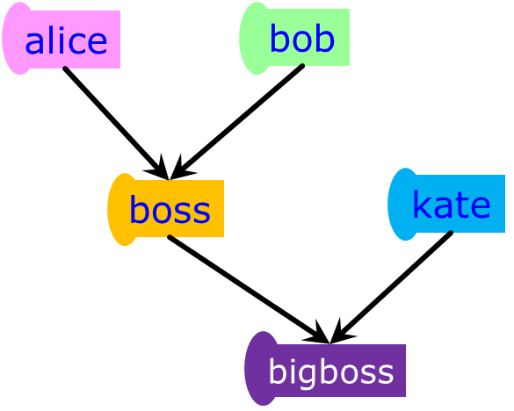
Different Way to Go at It [Assume only two threads available]
Approach on previous slide might be improved if only two OpenMP threads
Also depends how balanced the “alice”, “bob” and “kate” jobs are
Better use of resources (consequence of implicit synchronization at end of parallel block):
Step 1: use one sections to handle alice and bob
Step 2: use another sections to handle kate and boss
Step 3: bigboss executed by master threads

Slide 49
Advantage of Parallel Sections
Independent sections of code can execute concurrently → reduces execution time
Time
(Execution Flow)
#pragma omp parallel sections
{
#pragma omp section
phase1();
#pragma omp section
phase2();
#pragma omp section
phase3();
}
Serial
Parallel
The pink and green tasks are executed
at no additional time-penalty in the
shadow of the blue task
[IOMPP]→

Slide 50
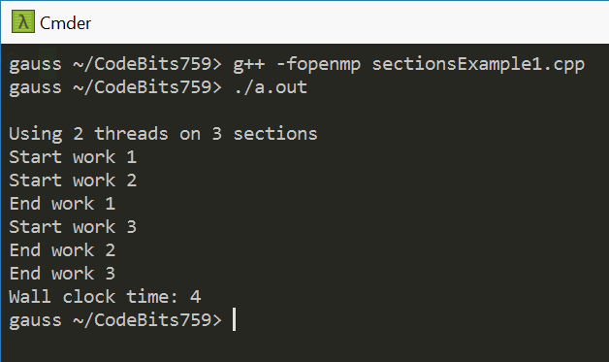
Example, sections: using 2 threads
#include <stdio.h>
#include <omp.h>
void spin_in_place(double duration) {
double start_time = omp_get_wtime();
while (omp_get_wtime() - start_time < duration) {}
}
int main() {
printf("\nUsing 2 threads on 3 sections\n");
double start_time = omp_get_wtime();
#pragma omp parallel sections num_threads(2)
{
#pragma omp section
{
printf("Start work 1\n"); spin_in_place(2); printf("End work 1\n");
}
#pragma omp section
{
printf("Start work 2\n"); spin_in_place(2); printf("End work 2\n");
}
#pragma omp section
{
printf("Start work 3\n"); spin_in_place(2); printf("End work 3\n");
}
}
printf("Wall clock time: %.2g\n", omp_get_wtime() - start_time);
return 0;
}
Note: The host machine (gauss) has tons of cores.

Slide 51
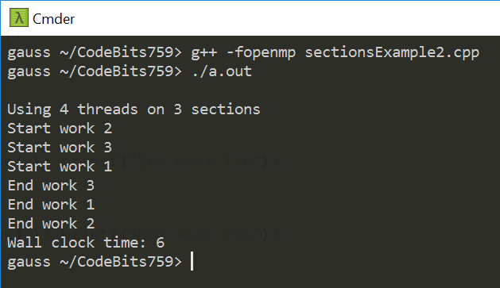
Example, sections: using 4 threads
#include <stdio.h>
#include <omp.h>
void spin_in_place(double duration) {
double start_time = omp_get_wtime();
while (omp_get_wtime() - start_time < duration) {}
}
int main() {
printf("\nUsing 4 threads on 3 sections\n");
double start_time = omp_get_wtime();
#pragma omp parallel sections num_threads(4)
{
#pragma omp section
{
printf("Start work 1\n"); spin_in_place(2); printf("End work 1\n");
}
#pragma omp section
{
printf("Start work 2\n"); spin_in_place(6); printf("End work 2\n");
}
#pragma omp section
{
printf("Start work 3\n"); spin_in_place(2); printf("End work 3\n");
}
}
printf("Wall clock time: %.2g\n", omp_get_wtime() - start_time);
return 0;
}
!
Note: The host machine (gauss) has tons of cores.
!

Slide 52
Work Plan, OpenMP
What is OpenMP?
Parallel regions
Work sharing – Parallel tasks
Variable Scoping Issues
Synchronization
Performance issues
Loose ends

Slide 53
OpenMP tasks
Task – Most important feature added as of OpenMP 3.0 version
Allows parallelization of irregular problems
Unbounded loops
Recursive algorithms
Producer/consumer
Start with brief discussion why the task OpenMP construct useful
[IOMPP]→

Slide 54
OpenMP Tasks – Motivation [1/3]
Parallelization of a dynamic list traversal: it couldn’t be done in OpenMP for a long while
OpenMP was initially “somewhat tailored for large array-based applications.”
OpenMP Application Program Interface, version 2.5 – OpenMP ARB, May 2005
p = listhead;
while (p) {
process(p);
p = next(p);
}
[IEEE TPDS 20(3), pp. 404-418, 2009]→

